Slide 1
L04.03 Linear Time sorting
50.004 Introduction to Algorithm
Dr. Simon LUI
ISTD, SUTD

Slide 2
Objective
The comparison model for sorting and searching
O(n) sorting algorithms (for small integers)
counting sort
radix sort

Slide 3
Comparison sort
All the sorting algorithms we have seen so far are comparison sorts: only use comparisons to determine the relative order of elements
e.g., merge sort, insertion sort
The best running time that we’ve seen for comparison sorting is O(n log n)
Is O(n log n) the best we can do?
Decision trees can help us answer this question

Slide 4
Decision-tree
A given + complete recipe for sorting n numbers
- This is an example of sorting 3 numbers
1:2
2:3
1:3
- i:j means compare i^{th} and j^{th} number
123
1:3
213
2:3
- Leaves are the results
132
312
231
321
Notes:
don’t care what the boxes contain

Slide 5
Decision-tree example
Sort a₁=9, a₂=4, a₃=6
1:2
1:2
1:2
9 > 4
2:3
1:3
123
1:3
213
2:3
132
312
231
321
Each internal node is labeled i:j for i, j ιν {1, 2,…, n}
The left subtree shows subsequent comparisons if a_{i} ≤ a_{j}
The right subtree shows subsequent comparisons if a_{i} > a_{j}

Slide 6
Decision-tree example
Sort a₁=9, a₂=4, a₃=6
1:2
2:3
1:3
9 > 6
123
1:3
213
2:3
132
312
231
321
Each internal node is labeled i:j for i, j ιν {1, 2,…, n}
The left subtree shows subsequent comparisons if a_{i} ≤ a_{j}
The right subtree shows subsequent comparisons if a_{i} > a_{j}

Slide 7
Decision-tree example
Sort a₁=9, a₂=4, a₃=6
1:2
2:3
1:3
123
1:3
213
2:3
4 ≤ 6
132
312
231
321
Each internal node is labeled i:j for i, j ιν {1, 2,…, n}
The left subtree shows subsequent comparisons if a_{i} ≤ a_{j}
The right subtree shows subsequent comparisons if a_{i} > a_{j}

Slide 8
Decision-tree example
Sort a₁=9, a₂=4, a₃=6
1:2
2:3
1:3
123
1:3
213
2:3
132
312
231
321
4 ≤ 6 ≤ 9
Each leaf contains a permutation π(1), π(2),…, π(n) to indicate that the ordering a_{π(1)} ≤ a_{π(2)} ≤ L ≤ a_{π(n)} has been established

Slide 9
Decision-tree model
A decision tree can model the execution of any comparison sort:
One tree for each input size n
A path from the root to the leaves of the tree represents a trace of comparisons that the algorithm may perform
The running time of the algorithm = the length of the path taken
Worst-case running time of the given algorithm = height of tree

Slide 10
Lower bound for decision-tree sorting
Theorem. Any decision tree that can sort n elements must have height Ω(n lg n)
Proof. (Hint: how many leaves are there?)
The tree must contain ≥ n! leaves, since there are n! possible permutations = n! possible answers
A height-h binary tree has ≤ 2^{h} leaves
Thus

Slide 11
Why it is Ω(nlogn)
Why Ω(nlogn):
log(n!)
>= n/2 log(n/2) + [(n-1)/2] log2
= n/2 log(n/2) + (n/2) log 2 – ½ log 2
= n/2 log(n) – ½

Slide 12
Linear time sorting
We sort n keys
If keys are (“small”) integers in {0,1,…,k-1}, is it possible to sort them without comparing them?
then lower bound of Ω(nlogn) does not apply
will prove that if k ≤ n^{c} then we can sort in O(n) time
Two algorithms: counting sort, radix sort

Slide 13
Counting sort
A[i]:
satellite data
key
Given: an array A[0],…,A[n-1] of n keys to be sorted
The n keys are integers in {0,1,…,k-1}
- B = array of k empty lists (linked, or Python lists)
- for j in range(n):
B[A[j]].append(A[j])
- output = []
- for i in range(k):
output.extend(B[i])
B[0..9]
B[0]
[ ]
n=5
B[1]
[ ]
B[2]
[ ]
2
5
9
8
2
B[3]
[ ]
B[4]
[ ]
keys in 0..9
k
B[5]
[ ]
B[6]
[ ]
B[7]
[ ]
B[8]
[ ]
B[9]
[ ]

Slide 14
Counting sort
Given: an array A[0],…,A[n-1] of n keys to be sorted
The n keys are integers in {0,1,…,k-1}
- B = array of k empty lists (linked, or Python lists)
- for j in range(n):
B[A[j]].append(A[j])
- output = []
- for i in range(k):
output.extend(B[i])
B[0]
[ ]
n=5
B[1]
[ ]
B[2]
[ ]
2
2
2
5
9
8
2
B[3]
[ ]
B[4]
[ ]
B[5]
[ ]
5
keys in 0..9
[ ]
B[6]
B[7]
[ ]
B[8]
[ ]
8
B[9]
[ ]
9
“stable sorting”
2
2
5
8
9

Slide 15
Counting sort
Given: an array A[0],…,A[n-1] of n keys to be sorted
The n keys are integers in {0,1,…,k-1}
- B = array of k empty lists (linked, or Python lists)
O(k)
- for j in range(n):
B[A[j]].append(A[j])
- output = []
- for i in range(k):
output.extend(B[i])
O(n)
O(1)
Total time: Θ(n+k)

Slide 16
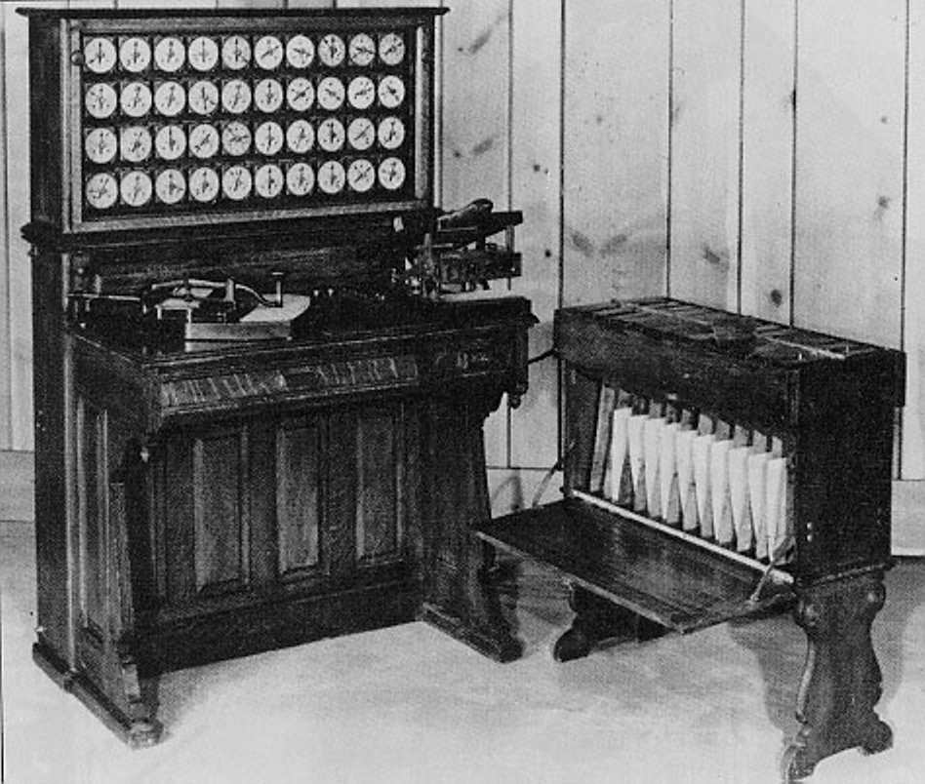
Radix sort
Origin: Herman Hollerith’s card-sorting machine for the 1890 U.S. Census
Digit-by-digit sort
Idea: Sort on least-significant digit first

Slide 17
Example of radix sort
3 2 9
7 2 0
7 2 0
3 2 9
4 5 7
3 5 5
3 2 9
3 5 5
6 5 7
4 3 6
4 3 6
4 3 6
8 3 9
4 5 7
8 3 9
4 5 7
4 3 6
6 5 7
3 5 5
6 5 7
7 2 0
3 2 9
4 5 7
7 2 0
3 5 5
8 3 9
6 5 7
8 3 9

Slide 18
Correctness of radix sort
t
t-1
t-2
Induction on digit position
Assume that the numbers are sorted by their low-order t – 1 digits
7 2 0
3 2 9
3 2 9
3 5 5
4 3 6
4 3 6
8 3 9
4 5 7
3 5 5
6 5 7
Sort on digit t
4 5 7
7 2 0
6 5 7
8 3 9

Slide 19
Correctness of radix sort
Induction on digit position
Assume that the numbers are sorted by their low-order t – 1 digits
7 2 0
3 2 9
3 2 9
3 5 5
4 3 6
4 3 6
8 3 9
4 5 7
Sort on digit t
Two numbers that differ in digit t are correctly sorted
3 5 5
6 5 7
4 5 7
7 2 0
6 5 7
8 3 9

Slide 20
Correctness of radix sort
Induction on digit position
Assume that the numbers are sorted by their low-order t – 1 digits
7 2 0
3 2 9
3 2 9
3 5 5
4 3 6
4 3 6
8 3 9
4 5 7
Sort on digit t
Two numbers that differ in digit t will be correctly sorted
Two numbers equal in digit t are put in the same order as the order based on the previous t-1 digits, which will be correctly sorted
3 5 5
6 5 7
4 5 7
7 2 0
6 5 7
8 3 9

Slide 21
Runtime analysis of radix sort
We are given n integers, each integer ≤ M, in base k
each integer has d = log_{k}M digits, a digit is in {0,1,…,k-1}
Assume counting sort is the auxiliary stable sort
M = 1000
d = 3
4 3 6
base k = 10
8 3 9
In practice we expect M to grow
as n grows, hence we assume M < n^{c}
n
3 5 5
…

Slide 23
Conclusions
lower bounds for searching and sorting algorithms
But O(n) is possible if:
if the range M of possible values grows at most proportionally with the size of the problem (size of problem = n = # of items), then we can use counting sort
if M grows even faster but O(n^{c}) for some c>1, then we can still keep the linear time result by using radix sort (and choosing optimally the base to represent our integers)

